Slide 1

Analyse Financial Data with Python Capstone project
Riina Trkulja – 19 July 2025

Slide 2

STOCKS WE ARE GOING TO ANALYSE AND WHY
SELECTION CRITERIA:
Technologically enabled
Going to transform the the world as we know it
Industries that are going to see incredible growth in next 5-10yrs:
Robotics
Artificial intelligence
Energy storage
Blockchain technology
Multiomic sequencing (lifescience) - is a research approach that integrates data from multiple "omics" levels (like genomics, transcriptomics, proteomics, etc.) to provide a more comprehensive understanding of biological systems and disease mechanisms. to reveal complex interactions and relationships within a cell or organism.
NVIDIA(NASDAQ: NVDA) is a technology company known for designing and manufacturing graphics processing units (GPUs) and system-on-a-chip units (SoCs). They are a leading force in accelerated computing, particularly in areas like gaming, professional visualization, data centers, and automotive. NVIDIA's GPUs are crucial for artificial intelligence (AI) and machine learning applications.

Slide 3


Our stocks: tesla
An autonomous vehicle is where the future of AI+robotics combine and we will be looking at companies who already have this technology.
Tesla Inc (NASDAQ: TSLA) – the entire ecosystem associated with autonomous taxi network is going be worth $8-10 trillion in revenue in the next 5-10 years. Cybercabs and Model Y’s are already autonomous. Transportation is one of the biggest economies in the world and autonomous taxies will become big part of that since they are significantly cheaper service than driver led vehicles. Robotaxi platform that facilitates people renting out their cars and people hailing autonomous taxies is a recurring revenue model.
Tesla robotics designs robots that are designed to mimic the human body in form and behavior. For example, Tesla Optimus was designed to do repetitive tasks in factories. However, this might be more than 10 years into the future, before the robotics get fully integrated into every home and workplace.

Slide 4

Our stocks: archer aviation
Since transportation becomes cheaper, there will be more cars on the roads.
The future technology will involve eVTOL – electric vertical take off and landing, which are effectively drones that can carry people.
Archer Aviation Inc (NYSE: ACHR) is a US based Aerospace company focused on developing eVTOLs aircraft for urban air mobility. Its flagship aircraft, the Midnight, is designed to carry four passengers and a pilot with a range of up to 100 miles and speeds reaching 150 mph. These vehicles can also be used in defense industry.

Slide 5
Our stocks: Palantir, crispr, vertex, aes
Palantir Technologies Inc (NASDAQ: PLTR) builds and deploys software platforms that help organizations integrate, manage, and analyze data to improve decision-making. Their platforms, particularly Palantir Gotham and Palantir Foundry, are used by both government agencies and commercial businesses for a variety of purposes, including defense, intelligence, and commercial operations. Their clients include NHS, Airbus and US Government.
AES Corp (NYSE: AES) is the next-generation energy company with over four decades of experience helping the world transition to clean, renewable energy. In June 2025 it completed First Phase of Largest Solar-Plus-Storage Project in the United States.
CRISPR Therapeutics AG (NASDAQ: CRSP)is an innovative pharmaceutical that works across a broad range of disease areas including hemoglobinopathies, oncology, diabetes and cardiovascular disease. CRISPR stands for clustered regularly interspaced short palindromic repeats – it is a groundbreaking gene editing technology that allows scientists to make precise, targeted changes to the DNA of living organisms.
Vertex Pharmaceuticals Inc (NASDAQ: VRTX)– innovative pharmaceutical tackling cystic fibrosis, sickle cell disease, type I diabetes, muscular dystrophy and many other serious diseases.

Slide 6
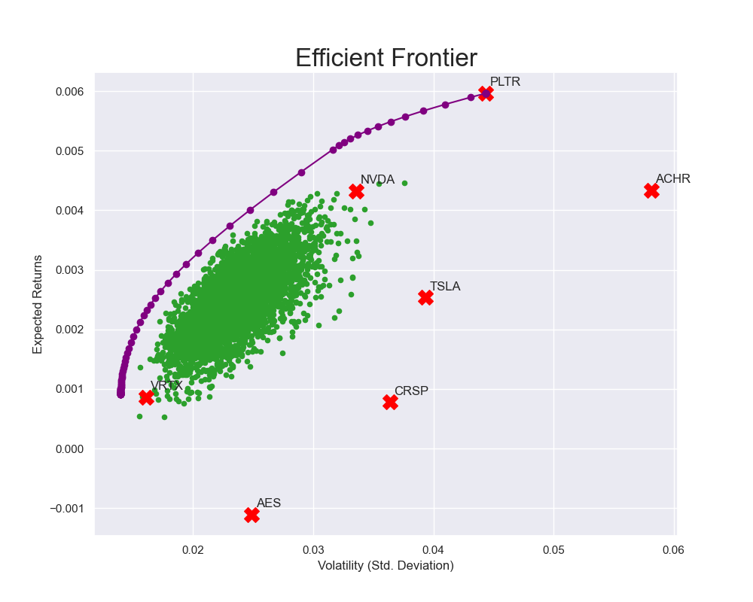
Efficient frontier and optimal portfolio
 | Weight
NVDA | 35%
PLTR | 28%
VRTX | 24%
CRSP | 5%
TSLA | 5%
ACHR | 2%
AES | 2%
Total | 100%
Returns | Volatility | Sharpe Ratio
0.0036 | 0.0233 | 0.1544

Slide 7
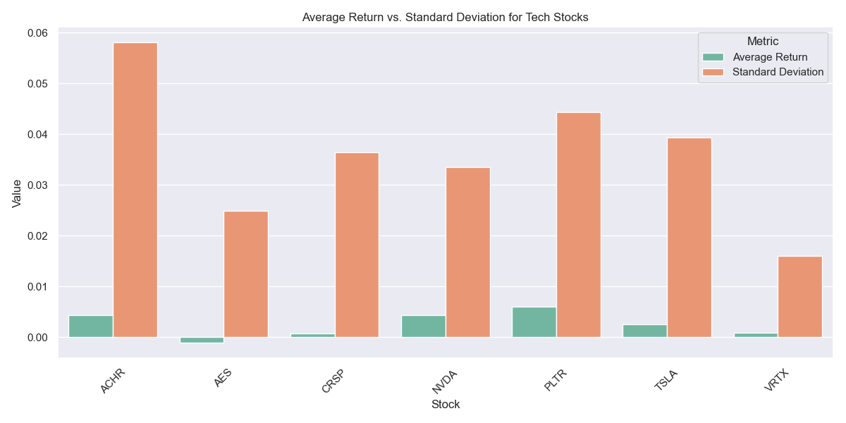
Returns vs risk for each stock
The riskiest asset by far is Archer Aviation Inc which makes sense since they are developing brand new technology - flying cars, that are effectively drones but can take 4 passengers and a pilot. It's all very exciting but still probably 7-10 years away in the future. It's for a risk-tolerant investor. AES seems to be a non-starter based on our analysis, they show negative returns. The reason why they are in the portfolio is the recent news in June 2025 they completed a first phase of largest solar-plus storage project in the US. Palantir shows high volatility, but recently they have really excelled in AI and Data analysis technology, so we are expecting great things here. Tesla has some amazing inventions and a strong pipeline, Elon Musk being a bit of a divisive figure will mean this stock is going to always be volatile. Recent blowout with Trump has not helped. We, however, believe in his hyper-focus and obsession, he has overcome some of the hardest challenges known to our era, therefore, we feel it's worth investing into. CRISPR Therapeutics is an innovative pharmaceutical company, they require huge capital for R&D, hence the high volatility. Perhaps a long-term investment for more risk-tolerant investor.

Slide 8
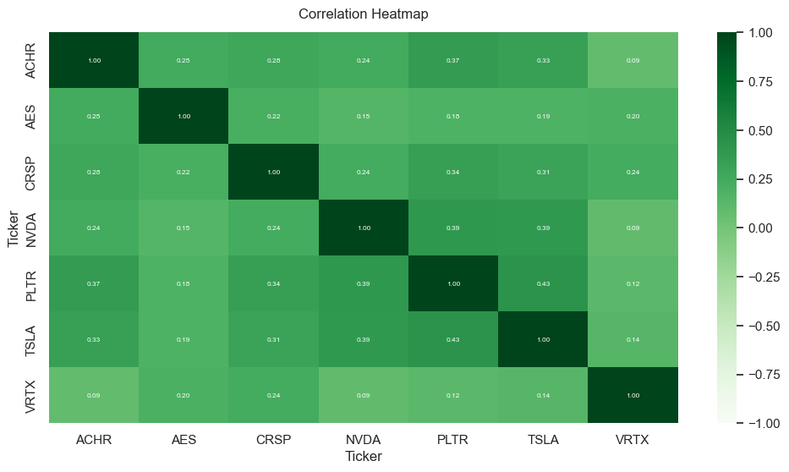
Correlation heatmap
Most stocks in this portfolio are weakly positively correlated. This means that when one stock increases, the other stock tends to increase slightly as well, but the relationship is not strong. The strongest relationship in this portfolio is between Tesla and Palantir at 0.433. The weakest realtionship is between Archer Aviation and Vertex Pharmaceuticals at 0.0855. A correlation coefficient of 0 suggests there is no linear relationship between the stocks. They move independently of each other.

Slide 9

Project instructions
Import/Download the Data
The financial data you use in this project is up to you. You can access financial data using one of the APIs accessed through the pandas-datareader package or from websites such as Yahoo Finance. Make sure to find data for at least, but not limited to, four (4) stocks to include in your analysis.
Load the data into a pandas DataFrame so you can easily view and manipulate the data.
Calculate Financial Statistics
Calculate some of the financial statistics you have learned about to gain insights into the stocks and how they relate to each other. What are the returns of the stocks over different time periods? How risky are each of the stocks when compared to each other? Do the returns of the stocks correlate with each other, or are they diversified?
You are working as a wealth manager at a small firm where you have clients seeking advice on how to invest their money. A young client wants to invest a large amount of their savings in a portfolio of stocks, but they are unsure of what stocks to invest in and at what amounts.
In this capstone project, you will create a presentation that showcases a portfolio of stocks that you recommend your client invest in, and provide the weights at which they should invest in each stock depending on their risk preference.
The purpose of this capstone is to practice accessing and downloading financial data, calculating financial statistics to understand the individual performance of an asset and how groups of assets are related, and how to allocate investments across assets for optimal performance
Compared to the other projects you have completed thus far, we are requiring few restrictions on how you structure your code. The project is much more open-ended, and you should use your creativity. In addition, much of the code you write for later parts of this project will depend on how you decide to implement earlier parts. Therefore, we strongly encourage you to read through the entire assignment before writing any code.

Slide 10
Project instructions (2 of 2)
Optimized Portfolio
Perform a mean-variance portfolio optimization that shows the efficient frontier for the group of stocks you have selected. If the investor is less risky, how should she allocate her funds across the portfolio? If she is more risky, how should she allocate her funds? Indicate multiple investment options at different risk levels and specify the returns.
Create Your Presentation
We want to see:
information about the stocks you utilized (industry, sector, background, news)
the key financial statistics about the stocks and how you interpret them
a few different portfolio options with the stock weights and why the investor would select that portfolio
an overall conclusion to the client about your recommendations
share your Presentation

